Slide 1
Chapter 8
Interrupt Structure of 8086

Slide 2
Introduction
“Interrupt” begins to our mind in many situations
When doing important task and it gets interrupted by some known or unknown person, so that we need to halt the work for few minutes and then continue later
It exactly the same that happens to a processor
As processor is connected to various peripherals and various programs stored in memory, there is a little chance of it to execute without interruption
keyboard is a peripheral connected to the processor
so processor expects a key to be pressed at any time

Slide 3
Interrupts of 8086
Interrupts are a part of the normal working of a processor
lets see the interrupt processing mechanism of 8086
It has Hardware, software & error generated interrupts
for all the 3 cases the interrupting mechanism is different, but the way the processor responds is similar
first we should know the way 8086 responds to interrupts
Point to note is that after an interrupt request is processed, the processor has to come back to its previous task that was left unfinished
so interrupt is not very much different from a CALL instruction

Slide 4
1.1 Interrupt response of 8086
After every instruction cycle, the processor checks if any interrupt is awaiting service
if it finds any interrupts and decides to acknowledge & service it, the response is the following sequence of steps:
The flag register is pushed on to the stack
The interrupt flag is disabled (IF=0)
The trap flag is disabled (TF=0)
The CS register is pushed on to the stack
The IP register is pushed on to the stack
Control is transferred to the location in which the corresponding “Interrupt Service Routine” is stored
the program corresponding to ISR is executed.
Then IP is popped out of the stack
CS is popped off the stack
The flag register is popped of the stack
Control returns to the point at which it had left

Slide 5
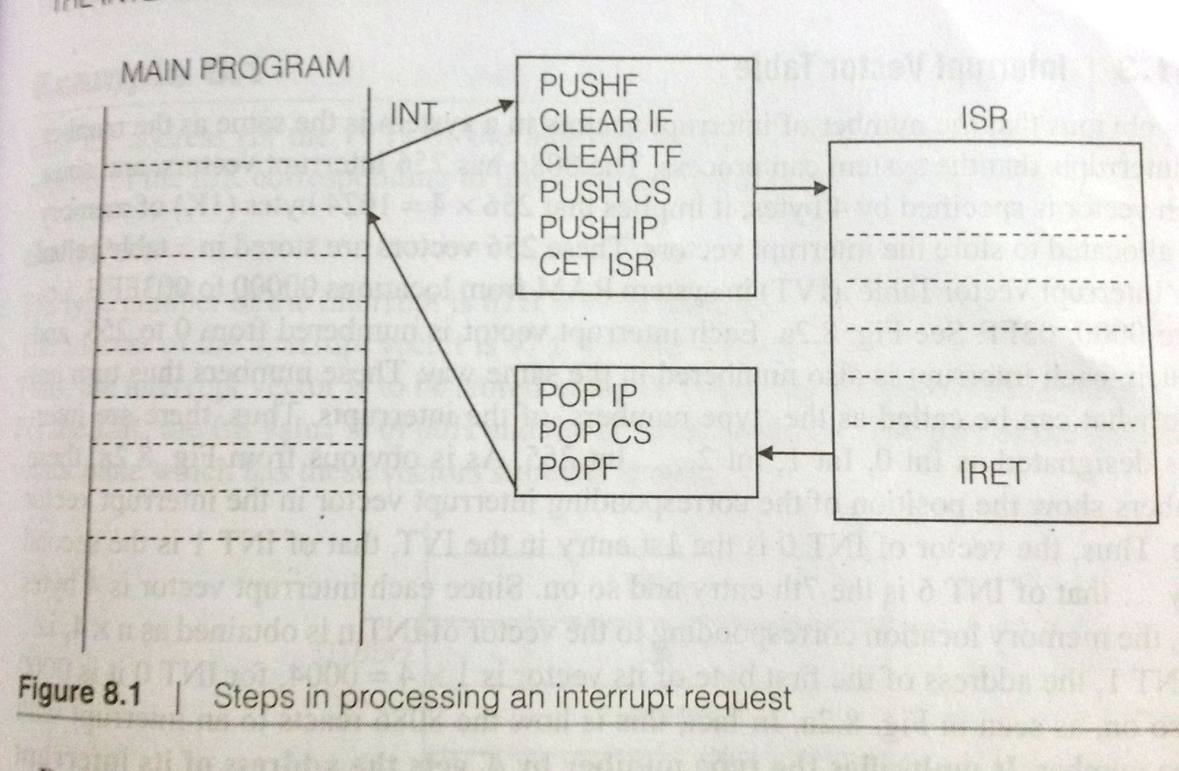
Steps 1 to 6 constitute the actions before getting to the interrupt service routine
steps 8 to 11 occur on returning from the interrupt

Slide 6
Interrupt service routine and Interrupt vector
when an interrupt occurs, the processor suspends the execution of its current task
takes on another task as required by the interrupting ssource
this program or routine as it may be called, is designated as an “Interrupt service routine”
it corresponds to a request of a particular source of interrupt and is called as an “Interrupt Handler”
means that for any interrupt occurs, there is a particular interrupt service routine
it is available in memory & must be accessed on the occurrence of the specific interrupt
for that the address of the ISR needs to be obtained
the address of an ISR is called its “Interrupt Vector”.

Slide 7
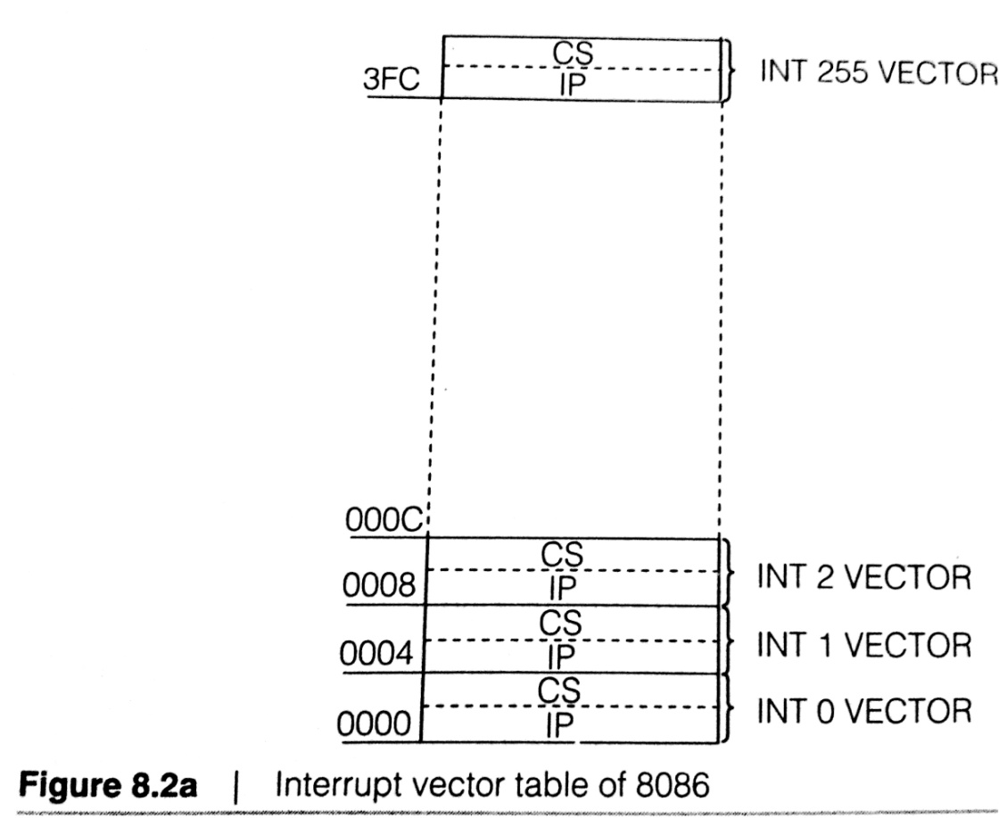
Interrupt Vector Table
the number of interrupt vectors in a system is the same as the number of interrupts that the system can process
8086 has 256 interrupt vectors and since each vector is specified by 4 bytes, it implies that 256x4=1024 bytes of memory is allocated to store the interrupt vectors

Slide 8
Interrupt Types
Intel has dedicated certain interrupt types for specific applications related to CPU operations. They are:
1. INT 0 (Divide by Zero Error)
the interrupt with type number 0
dedicated to the ‘divide by zero’
this interrupt is an ‘error generated’ interrupt or exception
on division if the quotient register is not large enough to contain the quotient, this interrupt generated automatically
dedicating Type 0 for the case means that the corresponding interrupt vector in the interrupt vector table is available at 0000:0000 (ref fig 8.2 a)

Slide 9
2. INT 1 (Single Stepping)
This type number is dedicated for ‘single stepping’ or ‘Trace’
It is important idea of debugging
during logical debugging of our programs, we would like to stop after execution of each instruction and check the contents of registers, memory & so on.
this action is performed by the use of ‘trace’
Intel has provided a trap flag for this
the ISR for viewing the register & memory contents will be pointed by the vector of interrupt type 1.
important issue is to know how to set the trap flag

Slide 10
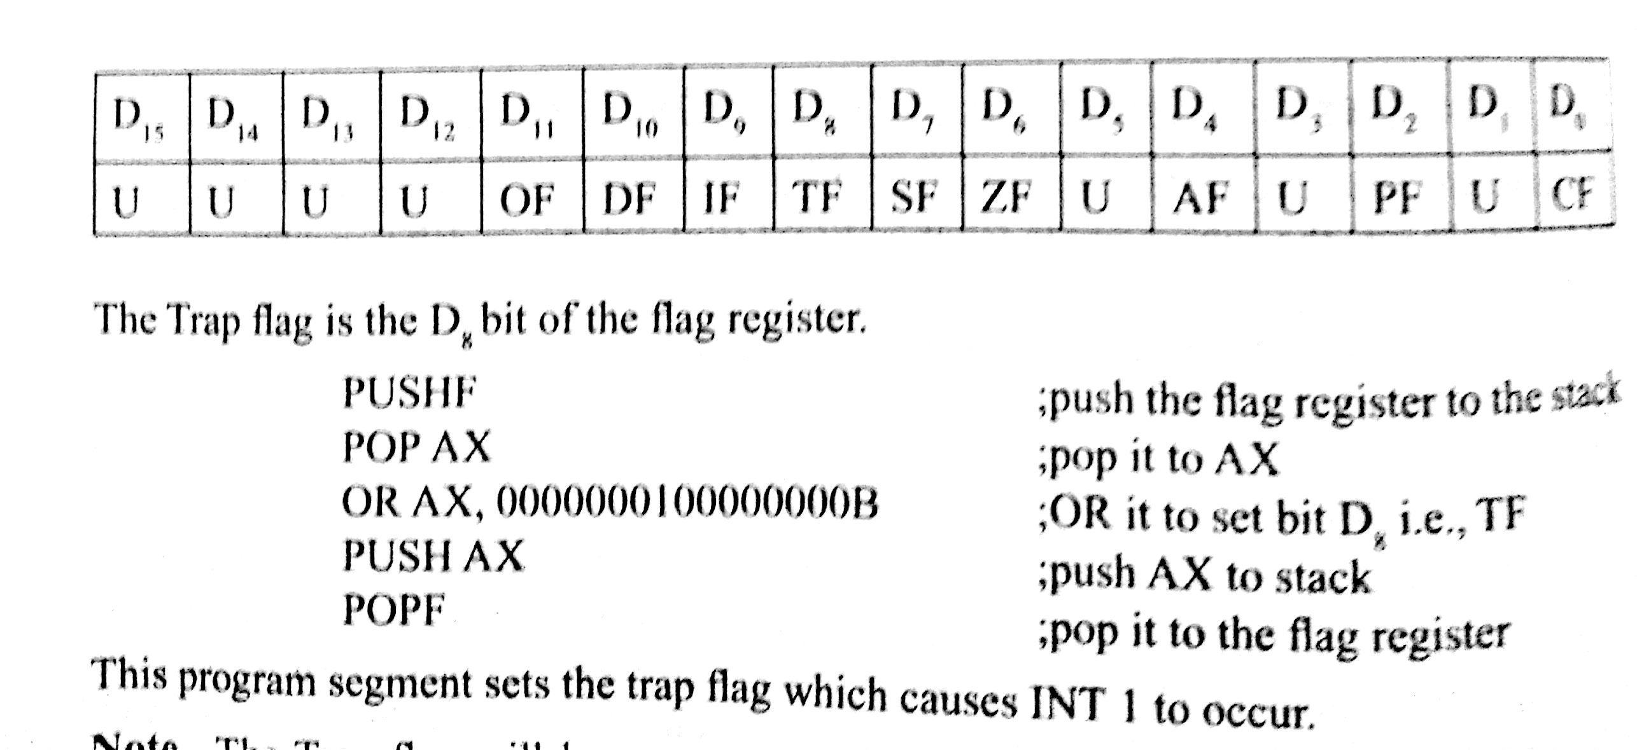
No such instructions has been considered so far
recollect the flag register configuration

Slide 11
3. INT 2 (Non Maskable Interrupt)
interrupt corresponds to a hardware interrupt NMI
when interrupt is received on pin NMI of the processor, a type 2 interrupt occurs
means ISR for NMI must be written in the address pointed by the corresponding IVT content
4. INT 3 (Break point Interrupt)
break point interrupt is useful for de-bugging
need to set breakpoints & check the content of registers & memory after executing instructions up to the breakpoint
its a single byte instruction code

Slide 12
5. INT 4 (Overflow Interrupt)
interrupt corresponds to overflow flag
if overflow flag is not set, this interrupt occurs but not automatically
An instruction INTO must be written after the program segment which is likely to cause the overflow flag to be set
MOV AL, Num1
MOV AL, Num2
INTO ;interrupt on overflow
Last line of program segement can pass control to the ISR written for INT , if the overflow flag is set by the result of addition
Otherwise INTO acts as NOP instruction.

Slide 13
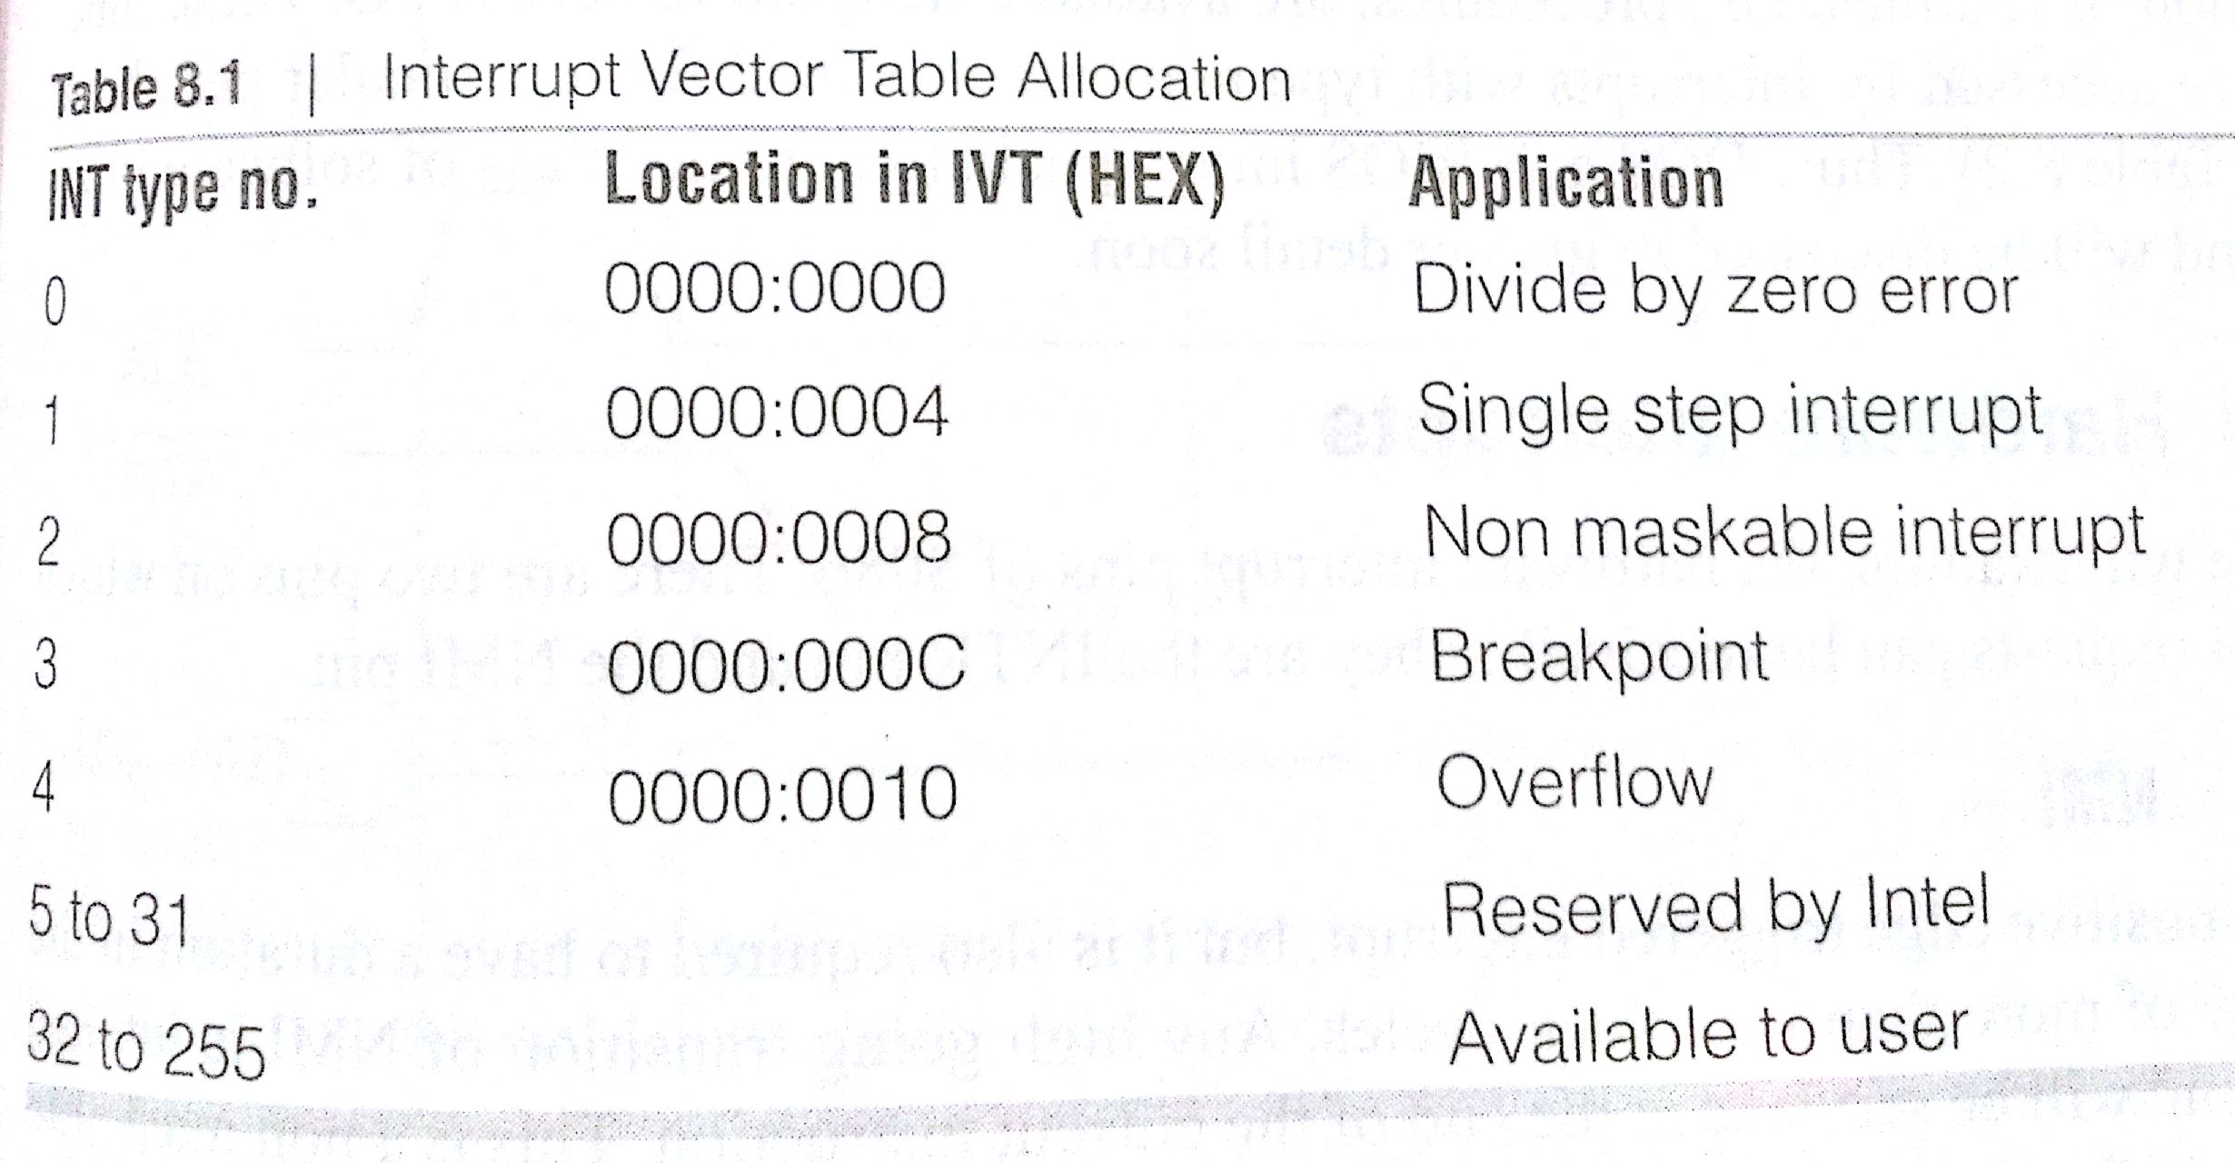
Allocation of Interrupt Types Numbers
interrupts with type 0 to 4 have been allotted pre-defined actions related to the CPU.

Slide 14
Software Interrupts
An interrupt initiated by an instruction is a software interrupt
INT type number (Eg: INT 21H etc..)
type number varies form 0 to 255
very important & interesting way of using procedure whose vectors are inserted into IVT
user can able to write procedure to ISR, store it in some address in memory and call it by using the instruction INT n
but user must however insert the CS & IP values of the ISR in the IVT in location corresponding to INT n
format of an interrupt instruction is INT n where n can only be a byte

Slide 15
DOS & BIOS Interrupt Routines
Here software is used in the form of DOS function INT 21H
DOS has a number of functions to access input/output devices
we can use these functions by knowing the interrupt type number
as absolute address of function need not be known
Besides DOS interrupts, there is another set of functions for I/O access
they are supplied by the system BIOS “Basic Input Output System”
A collection of routines

Slide 16
Hardware Interrupts
there are two pins on which interrupt requests can be received
INTR pin and the NMI pin
NMI
positive edge triggered interrupt
requires to have a high state of more than two clock cycles
the ongoing transition of NMI is latched on chip and will be serviced at the end of instruction
As this is a non maskable interrupt it does not depend on Interrupt flag (IF)
NMI caters to an application of the higher priority, like power failure.

Slide 17
INTR
This is a non-vectored interrupt pin in 8086
means that when an interrupt is request is received on this pin, it will not gets directed automatically towards any entry in the vector table
Also IF is required to be set for an interrupt request on the INTR line to be honored
when processor gets reset, all flags are found to be cleared & so the IF.
in order to acknowledge the INTR the IF is to be set by STI
INTR is a high level triggered interrupt

Slide 18
Can we consider Reset pin as an Interrupt Pin?
When reset pin is activated, the processor resets and control branches to the absolute address FFF0H
So Reset has a particular pointer or vector
Reset is sometimes included in the list of hardware interrupts along with NMI & INTR

Slide 19
Priority of Interrupts
As many interrupts occur at the same time, which source gets its request honored first?
So processor needs to decide on priority
The order of priority is set in the following manner:
1. Internal Interrupts and Software interrupts gets higher priority
2. NMI
3. INTR gets lower priority

Slide 20
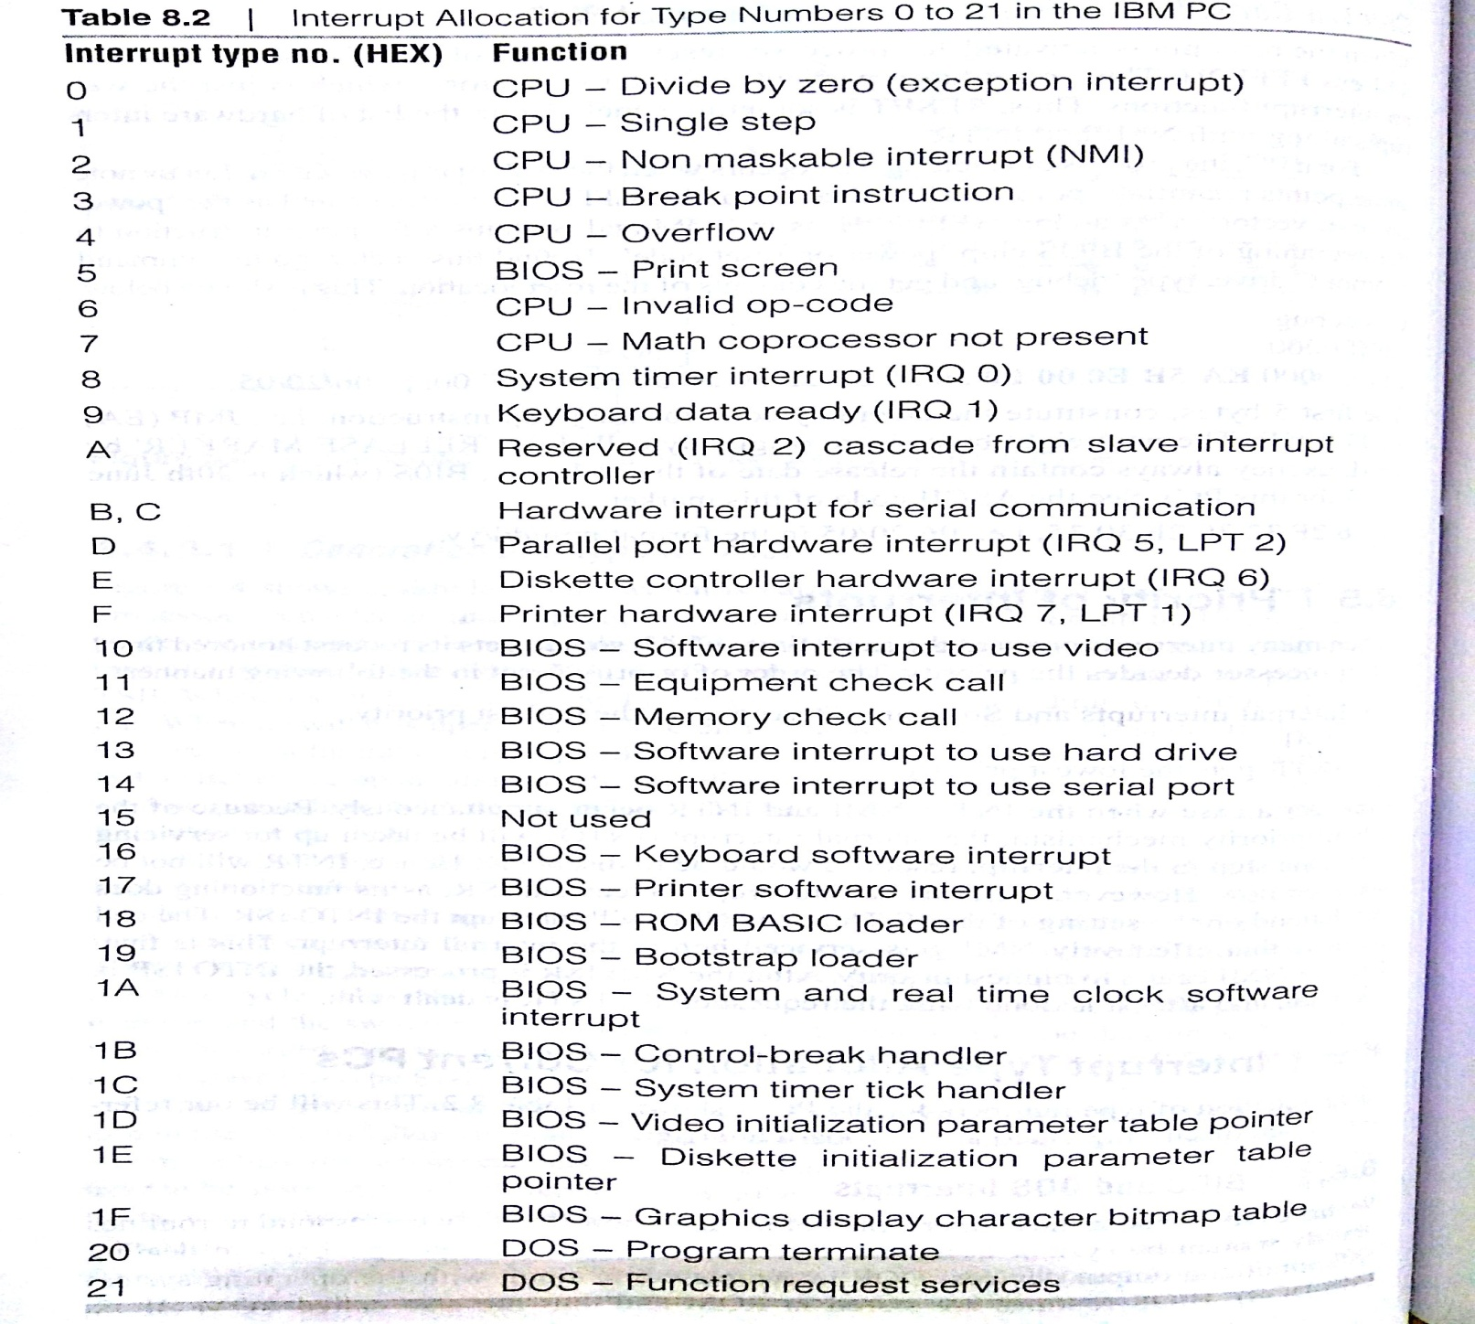
BIOS 10H Functions

Slide 21
Referring to the previous table, of interrupt vector allocation,
it can be seen that the type number 10H has been allocated for video display applications.
number of actions are possible using different function numbers to be loaded in AH
Also, each function requires that various information bytes to be loaded in specific registers
Many list of functions on INT 10H are available. (Ref Appendix D)
Will discuss a few of them used for various applications

Slide 22
Text & Graphics
Most basic classification of the display mode is “Text or Graphics”
In text mode, a monitor can able to display only ASCII characters
In graphical mode, a monitor can able to display any bit-mapped image
In addition to these, video adapters offer different modes of screen resolution & varying number of colour used.
The adapters used for these various display designations are:
1. CGA : Color Graphics Adapter
2. EGA: Extended Graphics Adapter
3. VGA: Video Graphics Adapter
4. SVGA: Super VGA

Slide 23
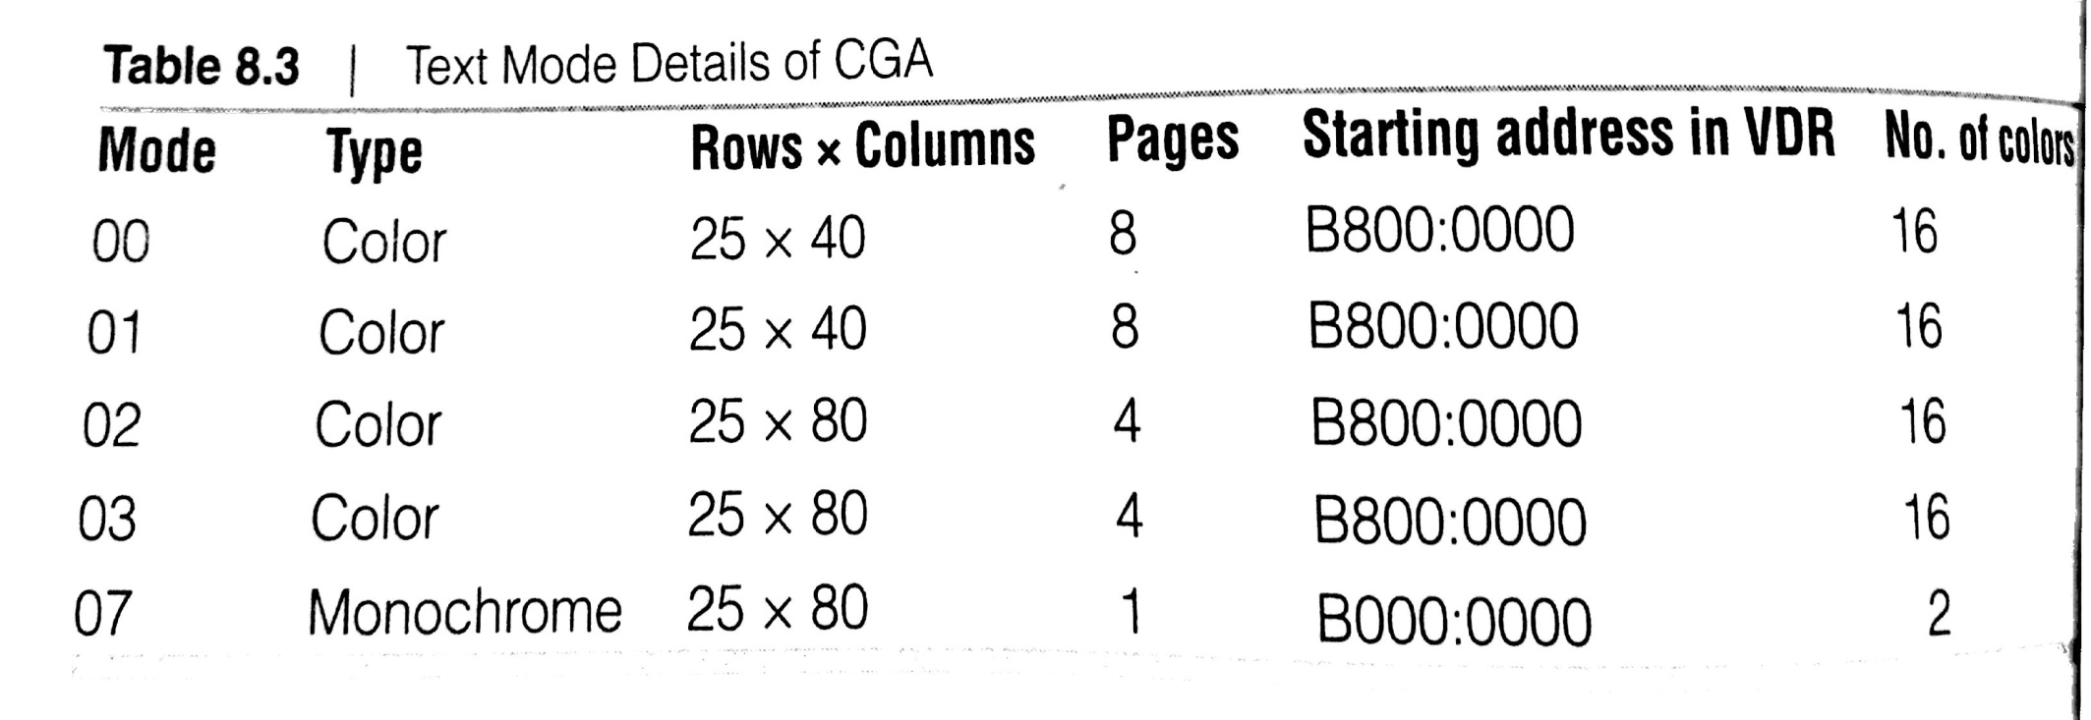
CGA this being the basic mode of colour displays
Table shows the text mode details of CGA
Only the text modes have been shown, and it corresponds to the CGA standard

Slide 24

BIOS 10H Function 0 - Set video mode
This function is used for setting video mode.
The function number is placed in AH
Video mode is place in AL
This function is for setting the video mode & it also clears the screen

Slide 25
BIOS 10H Function 2 - Set Cursor Position
This is for positioning the cursor
by specifying the row and column co-ordinates
row co-ordinate varies from 0 to 24
column varies from 0 to 79
following registers should contain the relevant information
BH= page numbers
DH = row
DL = column

Slide 26
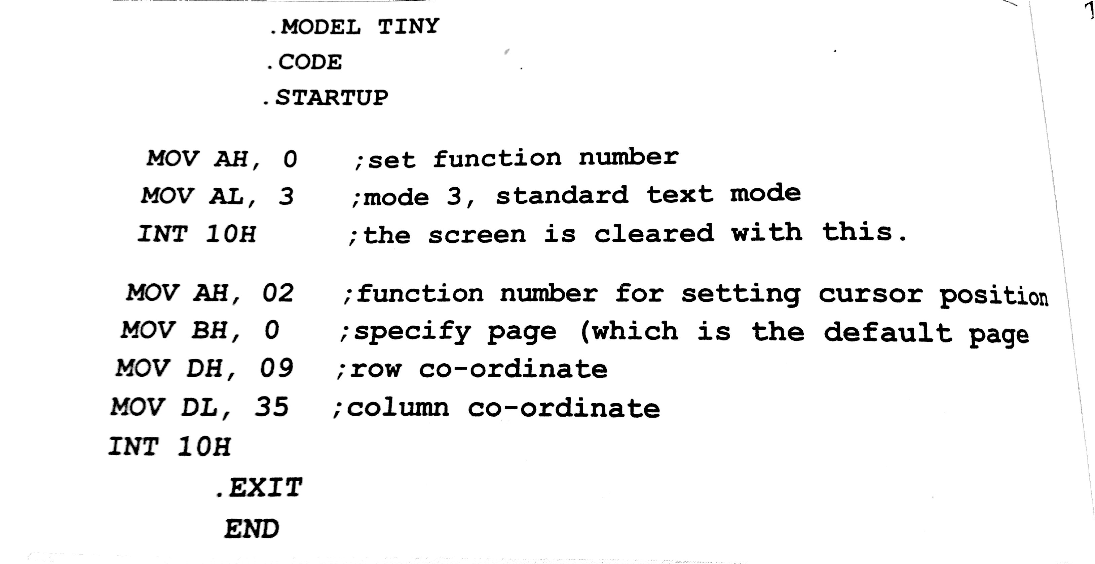

Slide 27
BIOS 10H Function 6 - Scroll up Screen
This functions scrolls up the screen by the specified number of lines and blank lines appear at the bottom
Registers involved & values to be stored are:
AL= number of lines to be scrolled up (0 for full blank screen)
BH= attribute value or pixel value
CH:CL = starting row: column
DH:DL = ending row: column

Slide 28
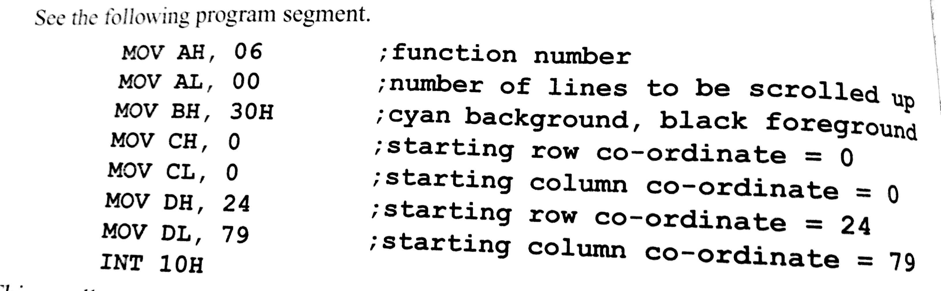

Slide 29
This scrolls up 0 lines
full cyan color screen is seen
Any text written on the screen will be of black color
The starting 0:0 (left hand corner of the screen & end point is the right corner (24,79)

Slide 30
BIOS 10H Function 09 - Display character with attribute at cursor position
This function displays a character at the cursor position
AL= ASCII character
BH= page number
BL = attribute type
CX = count

Slide 31
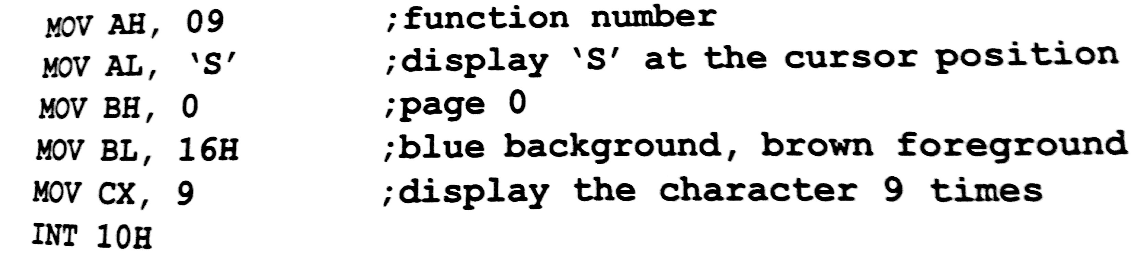
This program segment displays ‘S’ nine times starting at the position of the cursor

Slide 32
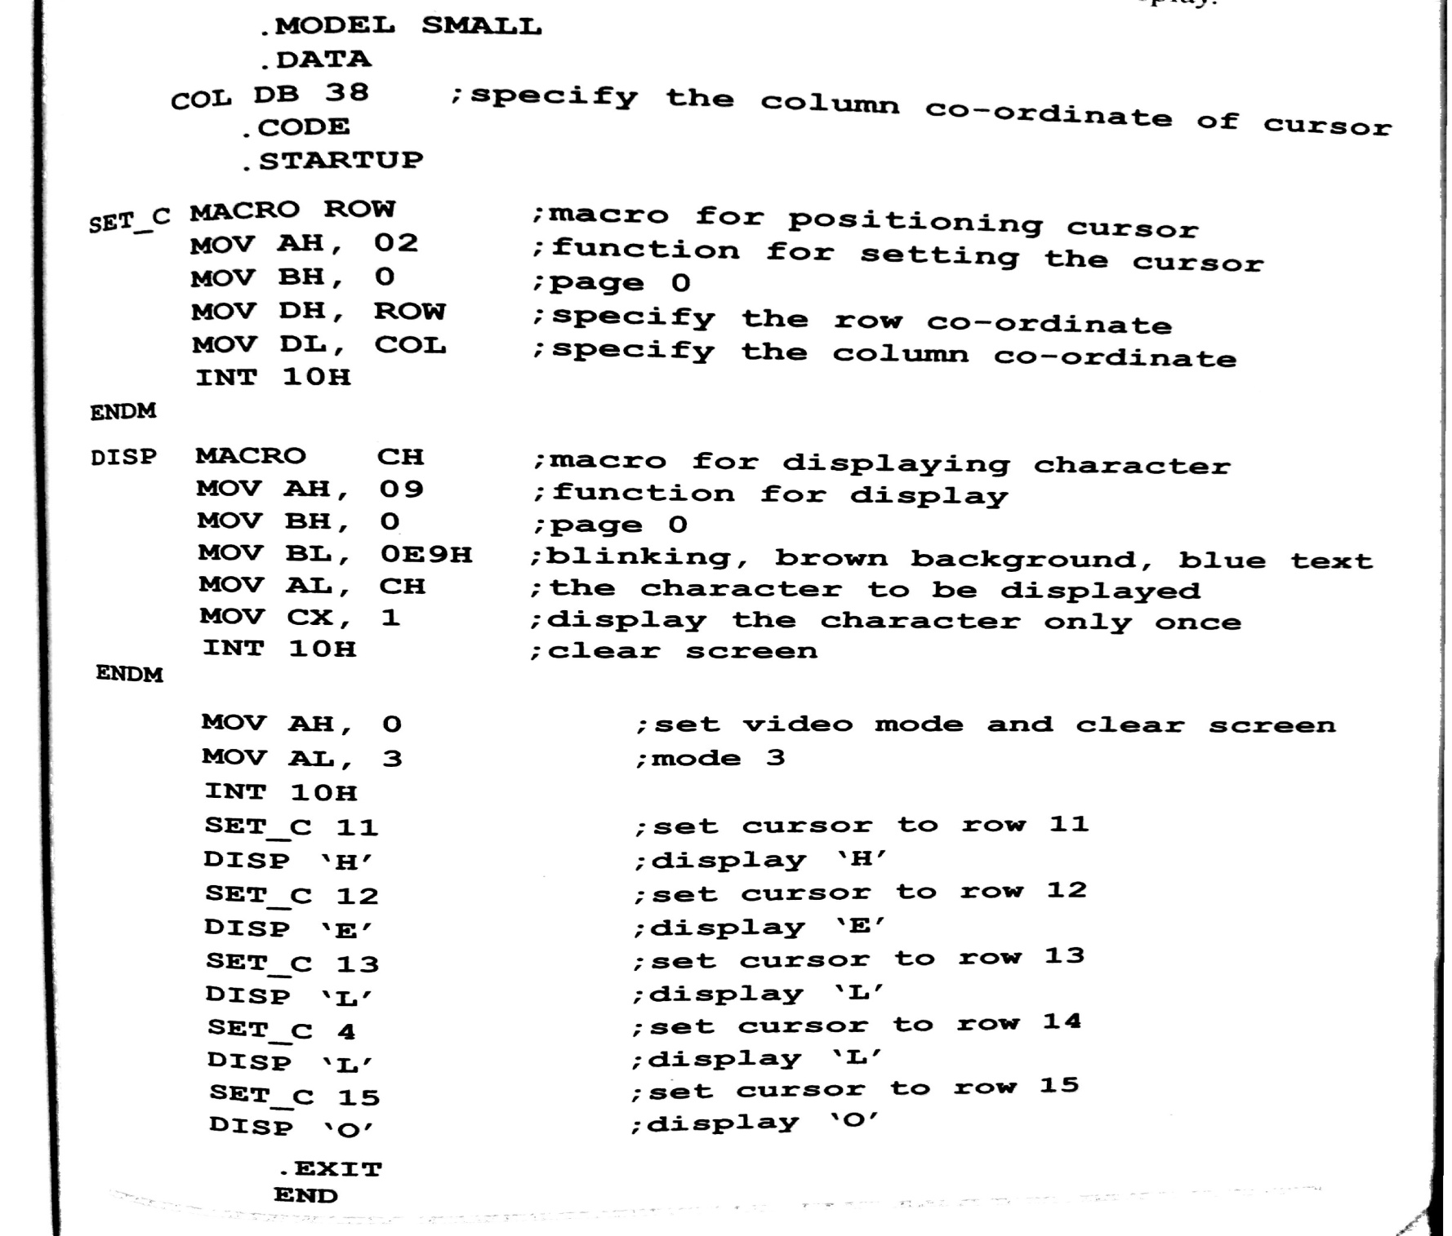
Write an ALP to display ‘HELLO’ vertically downwards at the centre of the screen

Slide 33
Fix up the initial cursor position. Write the first character
Next, increment the row o-ordinate of the cursor, and display the next character there. Repeat this for the whole string
To avoid writting a long program, lets use macros- one for setting the cursor set (SET_C) at different row co-ordinates ( column co-ordinate is kept constant at 38)and another for displaying characters at each cursor position (Disp)
The output of this program is a vertically display of HELLO, with blues text blinking on a brown background. Cursor will be at (15,38) after the display

